Slide 1

Deep Learning-Based Classification of
Liver Cancer Histopathology Images
Using Only Global Labels
AUTHORS: Hunli Sun, Ao Xu, Dong Liu , Zhiwei Xiong, Feng Zhao , and Weiping Ding
Team:
1. M Sampath Kumar (1806142)
2. M Vamsi (1806127)
3. Gaurav (1806146)

Slide 2
QUESTION PROBLEM:
Liver cancer detection is time consuming process as it is mostly done manually. As of now it is the major causes of death all over the world. To reduce the time consumption for the tumor detection manually and accurate prediction of the tumor is to be made. The problem is to reduce the time consumption and accurate prediction of the tumor using the deep learning.

Slide 3
DATASET:
The dataset was downloaded from the GDC portal.
It consists of whole slide images of liver tissue and are labelled and are available in SVS format.
The dataset consists of 105 abnormal files and 65 normal files.
The tissue slides were obtained at a fixed zoom level of 0.5 µm/pixel, corresponding to slides scanned at 20X magnification.
The histopathological images were randomly split into three datasets of 0.7 and 0.15, 0.15 corresponding to training, validation and testing dataset.
Slide Images | Normal | Abnormal
No. Of Images | 65 | 105

Slide 4
PREPROCESSING:
The original RGB image is converted to the HSV format for thresholding.
The H and S are thresholded using Otsu's binarization technique.
The masked H and S layers are merged with the V layer to get the HSV image again.
The resultant HSV image is then converted to the LAB format for color normalization.
Color normalization is performed by adaptive histogram equalization (AHEA).
AHEA is applied only for the L layer of the LAB image and then again merged.
The final image is then converted to the RGB format to get the preprocessed image.
The final image is then converted to the patches of size 224*224 and then each patch is given input to the ResNet50 as input.

Slide 5
Feature Extraction and Feature Selection:
The patch level feature vectors are obtained as output from the ResNet50.
Image level feature vectors are obtained by aggregating the patch level feature vectors by p-norm pooling, where p=3.
The final image level feature vector is of size 2048*1.
To remove the irrelevant features we take the top k values and bottom k values from the feature vector obtained. Here k=104.

Slide 6
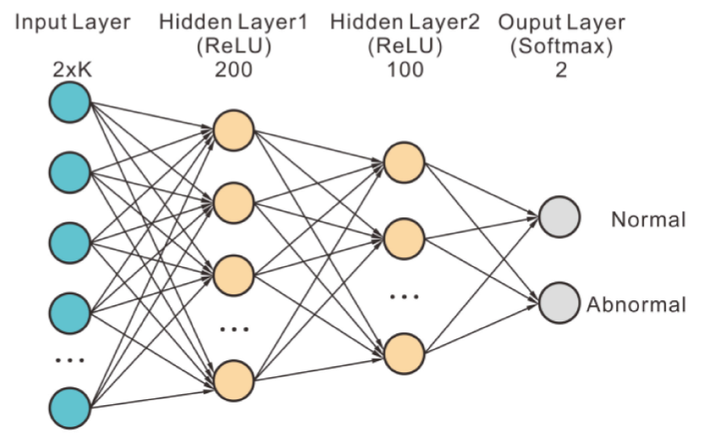
Multi Layer Perceptron:
The model has an input layer of size 2*K and has two hidden layers and an output layer.
The first hidden layer consists of 200 neurons, activation function as relu and kernel initializer as he-uniform.
The second hidden layer consists of 100 neurons, activation function as relu and kernel initializer as he-uniform.
The output layer contains two neurons and has an activation function as SoftMax.
We adopted the Adam optimizer [58] with a minimum batch size of 24 and a learning rate of 0.001 to optimize the binary cross-entropy loss.

Slide 7
Ensemble Model:
We used Ensemble model for achieving better classification performance.
We trained 10 model with model with different weights.
The prediction for histopathological images is the mean of these 10 model predictions.
L2 regularizations and dropout were both used in these 10 models to prevent overfitting.

Slide 8
Results:
As we used OpenCV library instead of OpenSlide library, the results are different.
The results are as shown in table.
Differences:
As the RAM in Google colab is not sufficient for using OpenSlide library, we converted the SVS files to PNG format and used the OpenCV library and scikit learn library for image preprocessing.
 | Accuracy | Precision | Recall | F1 Score
Original model | 98.6% | 0.99 | 0.99 | 0.99
Our model | 94.8% | 0.889 | 0.982 | 0.933

Slide 9
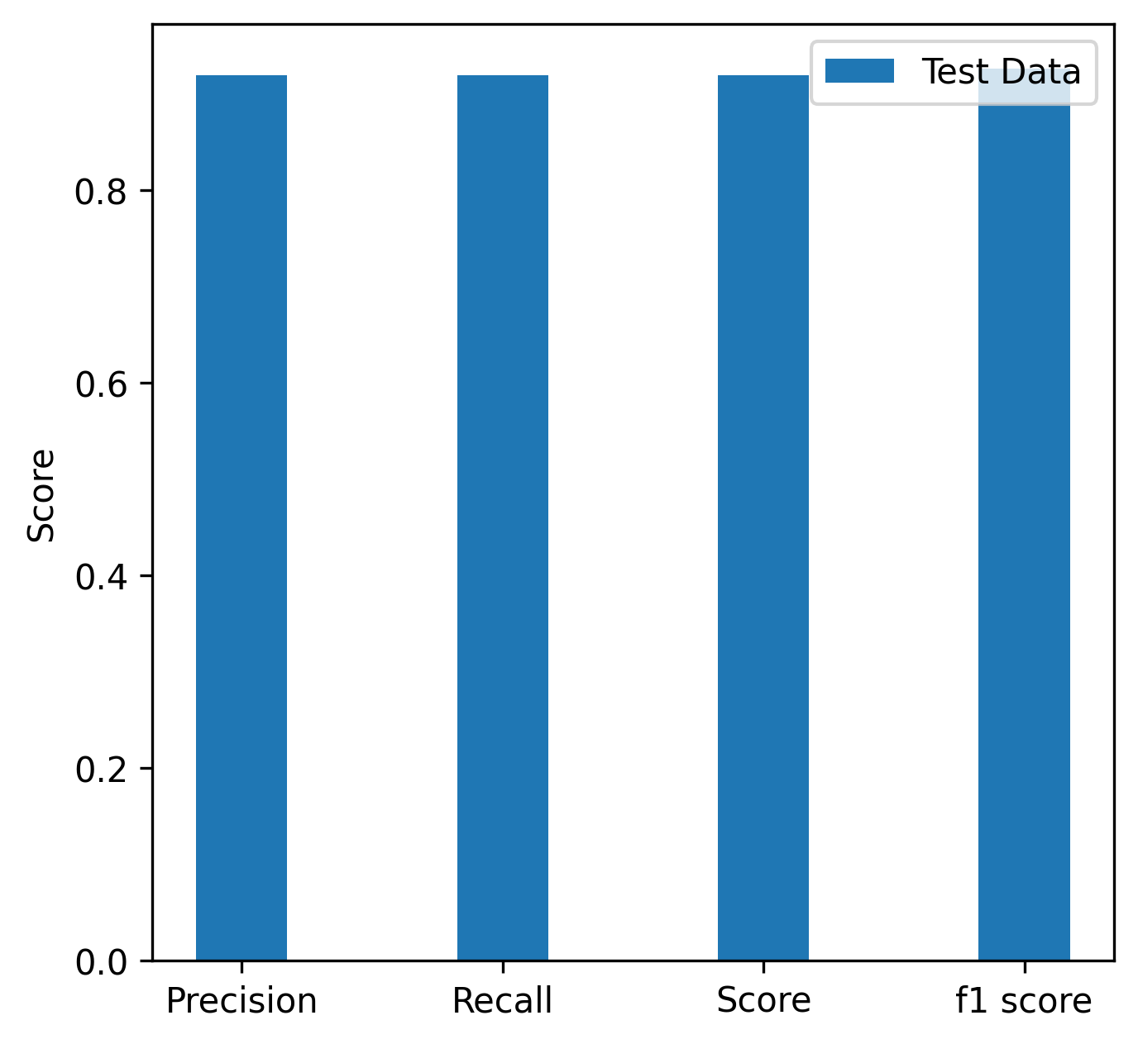
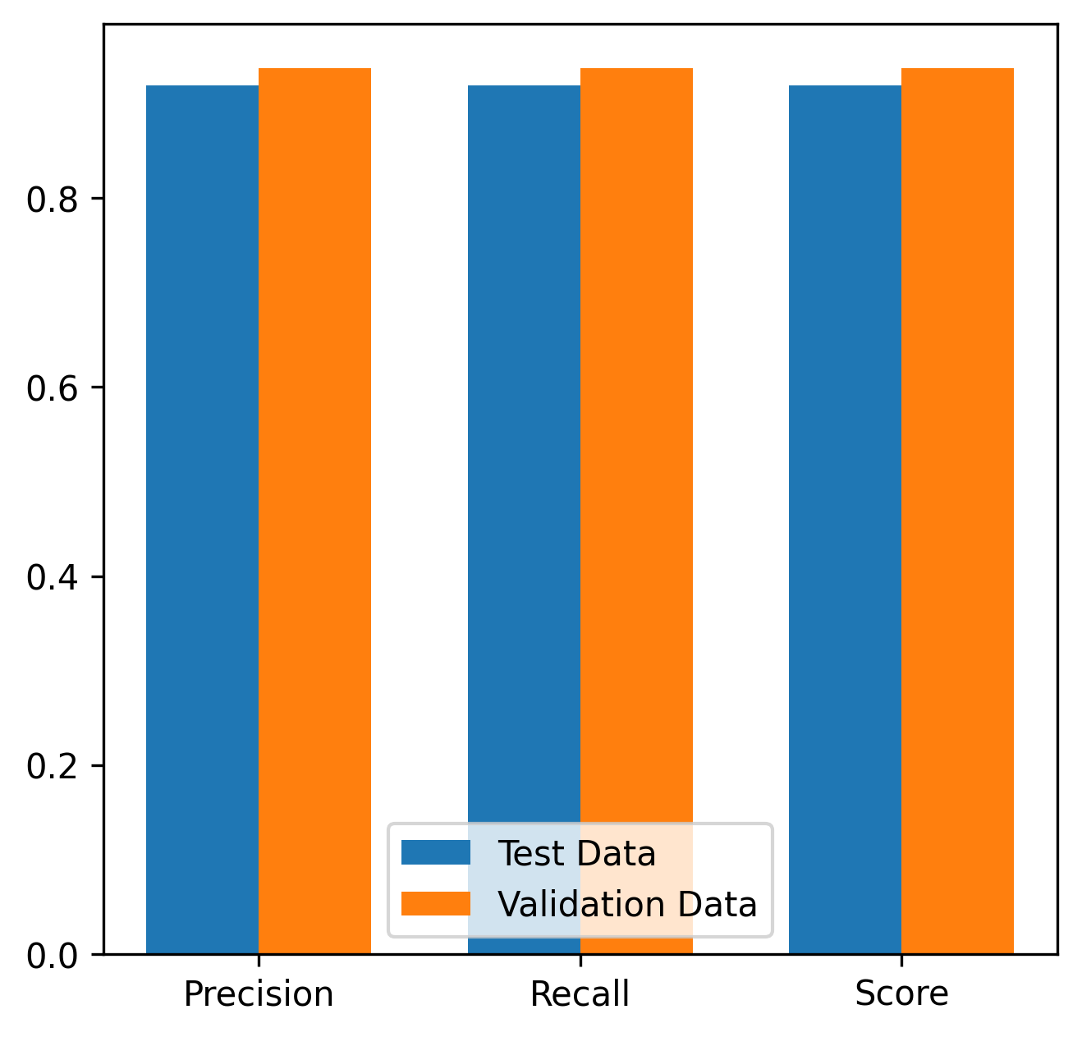
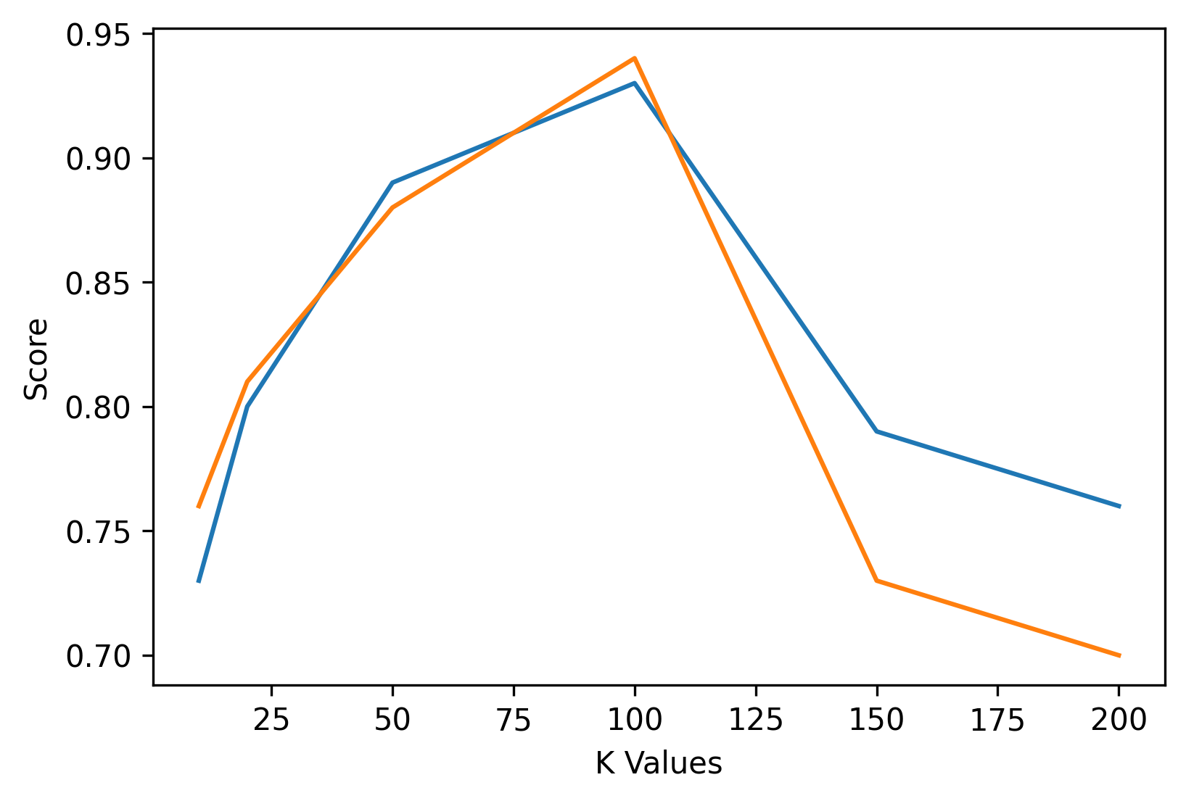
Plots:
Fig 1: Precision, recall, f1 score and accuracy for test data, Fig 2: ROC curve
Fig 3: Precision, recall and F1 score for test and validation datasets

Slide 10

THANK YOU

